Slide 1
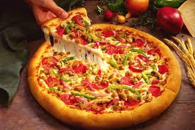
Pizza Place Sales
Project Owner: Abhijeet Ranjan

Slide 2
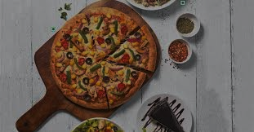
Content
Introduction
Goals and KPI’s
Recommended Analysis
Conclusion

Slide 3
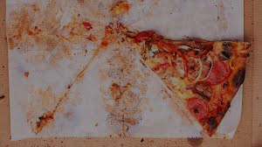
INTRODUCTION
Problem: - Pizza restaurant has recently seen a decline in sales and plans to increase them by looking at customer and order data. To do this, the management plans to perform a thorough analysis of order data and consumer behaviour in order to spot important trends and areas for improvement.
Background: - An overview of pizza sales data from January 2015 to December 2015 is given in this report. To find trends and patterns in pizza sales, data was gathered from pizza joints across the United States and analysed.

Slide 4
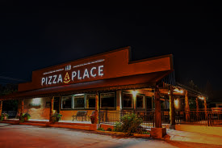
GOALS & KPI’S
Goals
Increase pizza sales by 10% within 6 months
Identify and address the root cause of the decline in sales
Improve customer satisfaction and loyalty
Gain a deeper understanding of customer behaviour and preferences
Key Performance Indicators (KPIs)
Total pizza sales revenue
Number of pizzas sold
Average order value

Slide 5
RECOMMENDED ANALYSIS
Find out how many customers do we have each day? Are there any peak hours?
There are two peak hours 12:00 PM to 1:00 PM & 5:00 PM to 6:00 PM.
On an average we have 60 customers per day.

Slide 6
How many pizzas are typically in order? Do we have any bestsellers?
We have 2 pizzas typically in an order and the bestseller pizza is big_meat_s.

Slide 7
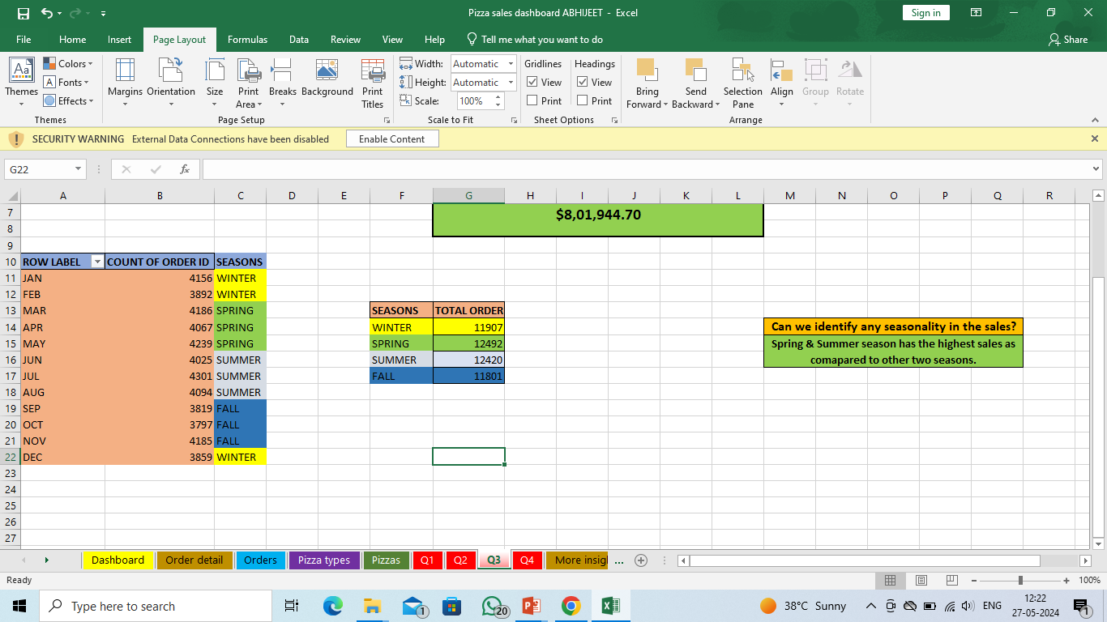
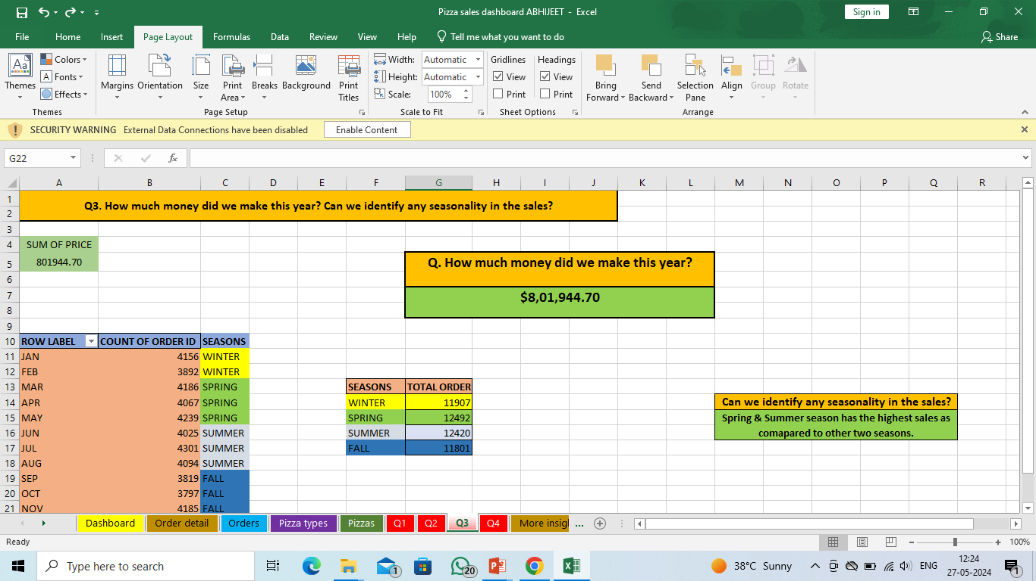
How much money did we make this year? Can we identify any seasonality in the sales?
We made this year $ 801,994.70 amount of money.
Spring & Summer Season has the maximum sale as compared to others seasons

Slide 8
Are there any pizzas we should take off the menu, or any promotions we could leverage?
We can take off the pizza from the menu is : the_greek_xxl reason is simple it is lowest ordered pizza in that year and Since the Spring & Summer season already saw the largest pizza sales and the Fall season saw the lowest pizza sales, so we can provide a seasonal discount or special offers according to season.

Slide 9
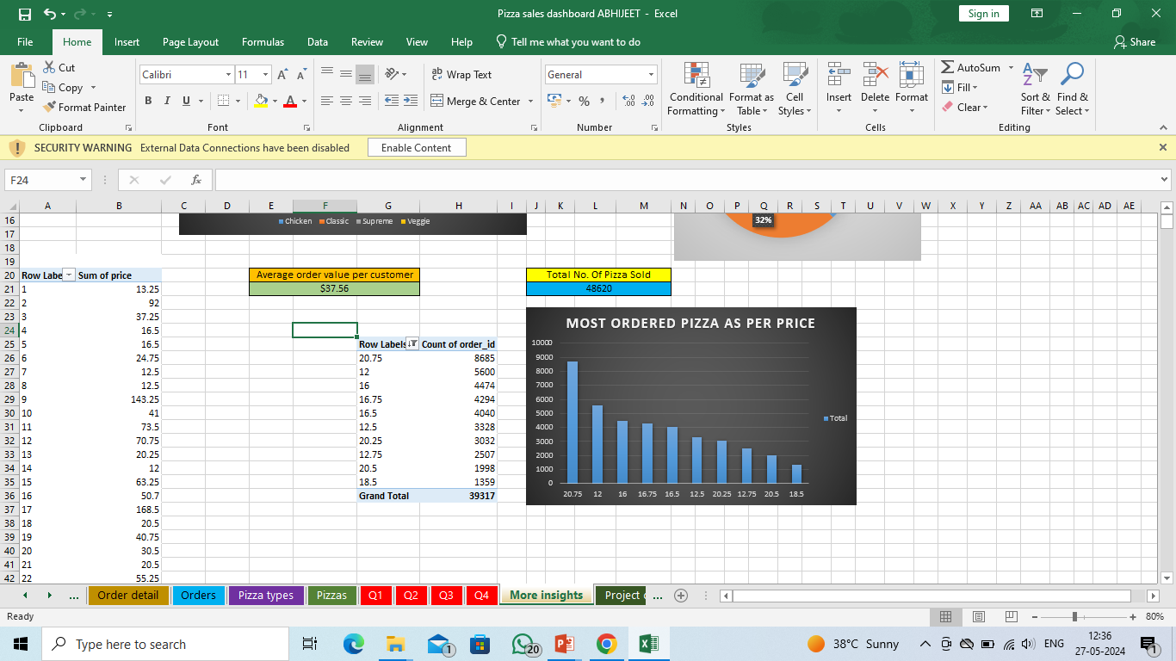

More Insights

Slide 10

Conclusion
The given dataset is a useful tool for examining the year's worth of sales at a fictitious pizza restaurant. It can be used to investigate a number of suggested analysis inquiries about pizza orders and sales. Depending on the precise issues and objectives of the analysis, Excel or other data analysis tools and techniques may be used.
The dataset provides a thorough overview of the sales and ordering trends for pizza, which may be utilised to develop insights and make sensible decisions.

Slide 11
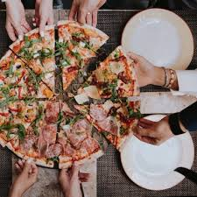




THANK YOU
www.linkedin.com/in/abhijeet-ranjan-958760191
abhijeetr162@gmail.com
abhijeetranjan
https://peerlist.io/abhijeetranjan

